Slide 1



INTELLIFLO REDBLACK
Name of Candidate : MUHAMMAD ANSHAD P A
Register No : 23204036
Date : 15/02/2025
Venue : RCSS
Programme : Master of Computer Applications
Batch : 2023-2025

Slide 2
OUTLINE OF THE PRESENTATION
01
Slide 1 : Introduction to the Internship
02
Slide 2 : About the Organization
03
Slide 3 : About the Platform/Tools
04
Slide 4 : Internship Objectives
05
Slide 5 : Weekly Overview
06
Slide 6 : Objectives Achieved
07
Slide 7 : Skills Achieved
08
Slides 9-10 : Challenges, Future Directions and Gantt Chart
09
Slide 10 : Conclusion

Slide 3
INTRODUCTION TO THE INTERNSHIP
Internship at Intelliflo Red Black as a Performance Testing Intern, focusing on scalability, reliability, and efficiency of applications.
Hands-on experience in Load Testing, Stress Testing, and Scalability Testing.
Utilized Apache JMeter, AWS CloudWatch, Grafana, GitLab, and Jenkins for performance benchmarking and automation.
Analyzed system performance under different workloads through real-world test scenarios.
Applied theoretical knowledge to practical performance testing strategies.
Collaborated with development and QA teams in an Agile environment, ensuring integration of performance testing into the software development life cycle.

Slide 4





ABOUT THE ORGANIZATION
Global leader in financial advice technology(Asset Management).
Parent Company : INVESCO
Invesco acquired RedBlack Software on December 11, 2019.
Intelliflo Redblack– Previously REDBLACK
30,000+ advisors and $1 trillion in assets managed
Provides software solutions for:
Practice management
Portfolio management
Digital advisory services
Uses cloud-based architecture to ensure high availability and security
Agile-driven development and testing

Slide 5






ABOUT THE PLATFORM/TOOLS
Apache JMeter – Performance Testing Tool for Load and Stress Testing
AWS CloudWatch – Performance monitoring for API services and background jobs
Grafana – Data visualization tool to analyze system behavior
JIRA – Bug tracking, test case management, and sprint planning
GitLab – Version control and CI/CD pipeline management for automated testing.
Jenkins – Continuous integration and automation tool for executing performance tests in pipelines
Slide No : 3

Slide 6
INTERNSHIP OBJECTIVES
1
Implement Performance Testing
2
Benchmarking Response Time, Throughput, CPU & Memory Utilization
3
Testing API services and background jobs to assess system performance
4
Testing Import Portfolio Data(Advent & Pershing Portfolio Evaluation Service)
5
Bug Tracking , Documentation & Report Generation
6
Agile Participation & Collaboration
Slide No : 4

Slide 7
WEEKLY OVERVIEW
Week 1
Introduction & Onboarding , Agile & Jira Training.
Introduction to Performance Testing , Load and Scalability Testing basics.
Week 2
Week 3
JMeter Hands-on Training , Implementation of Timers & Configuration Elements.
Week 4
Implementation of JMeter Assertions , Debugging Failures.
Slide No : 5

Slide 8
WEEKLY OVERVIEW
Week 5
Testing on API’s simple-asset-classifiers & securities. Implementation of JSON Extractor for Session Handling
Testing on Import Portfolio Data-(Advent) & Report Generation
Week 6
Week 7
Testing on Import Portfolio Data(Pershing) - Multiple Attempts Failures
Week 8
Import Portfolio Data (Pershing) Attempt Successful – Performance Analysis and Report Completion.
Slide No : 6

Slide 9
OBJECTIVES ACHIEVED
1. Successfully Implemented Performance Testing
2. Benchmarked System Performance Metrics
3. API & Background Jobs Performance Testing
4. Completed Testing on Import Portfolio Data – ( Advent & Pershing)
5. Documented Bug Tracking & Performance Reports.
6. Active Agile Participation
Slide No : 7

Slide 10
SKILLS ACHIEVED
TECHNICAL SKILLS:
PROFESSIONAL SKILLS:
Performance Testing
Problem-Solving
Load Testing, Stress Testing, Scalability Testing.
Identifying and optimizing system bottlenecks.
Performance Benchmarking
Collaboration & Communication
CPU Utilization, Response Time, API Throughput.
Working with developers and QA teams.
Debugging & Optimization
Time Management
JMeter Assertions, Log Analysis
Prioritizing tasks effectively in Agile environments.
Data Analysis & Monitoring
Analytical Thinking
Grafana, AWS CloudWatch for performance tracking.
Analyzing test data to make performance improvements.
Slide No : 8

Slide 11
CHALLENGES
1.Initial challenge: Complexity in configuring JMeter, Gatling, and AWS CloudWatch.
2. Test failures in initial attempts.
3. Simulating Realistic Load Conditions(Creating test cases that match real-world scenarios)
4. Adapting to Agile Workflows(Managing performance testing within sprint cycles)
FUTURE DIRECTIONS
Enhance automated test scripts for continuous performance monitoring
Optimize performance testing strategies for large-scale systems
Gain deeper expertise in CI/CD integration for automated performance testing
Integrating performance testing early in the development cycle.
Improving real-time tracking using AWS CloudWatch and Grafana.
Slide No : 9

Slide 12
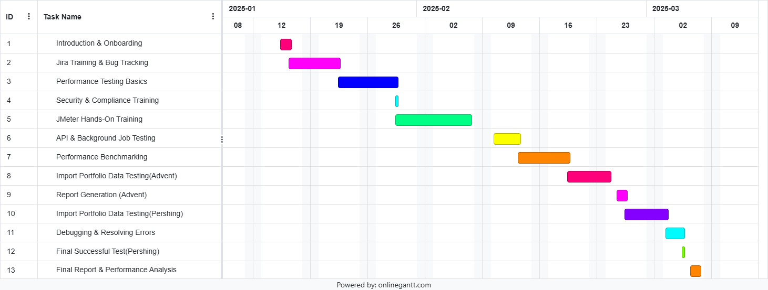
GANTT CHART
Slide No : 10

Slide 13
CONCLUSION
The internship at Intelliflo Red Black provided in-depth exposure to performance testing methodologies and real-world application testing scenarios.
Gained hands-on experience in Load Testing, Stress Testing, and Scalability Testing using Apache JMeter, AWS CloudWatch, Grafana, GitLab, and Jenkins.
Conducted detailed performance benchmarking, identified system bottlenecks, and developed automated testing solutions for continuous monitoring.
Collaborated with cross-functional teams and adapted to Agile workflows, participating in sprint planning, daily stand-ups, and retrospectives.
Overcame challenges related to analyzing large performance datasets, optimizing test cases, and managing performance testing within development cycles.
This experience significantly enhanced my technical expertise, problem-solving skills, and understanding of software performance optimization.
Slide No : 11

